Slide 1

Project: SQL Data Analysis & Visualization with Power BI for FDA (PART 2 – POWER BI)
ASSIGNMENT : 03
ABADS BATCH 12

Slide 2
Introduction:
The U.S. Food and Drug Administration (FDA) is a federal agency responsible for safeguarding public health in the United States. It oversees various areas, including food safety, pharmaceuticals, medical devices, cosmetics, tobacco, and veterinary products. The FDA evaluates the safety and efficacy of drugs, biological products, and medical devices, conducts inspections, and enforces regulations. It also regulates food production and distribution, conducts research, provides public health education, and monitors and responds to emerging health risks. The FDA's mission is to protect and promote public health by ensuring the safety and effectiveness of a wide range of products and substances. iVision is collaborating with FDA to perform Data analysis on FDA’s dataset. FDA has provided iVision with SQL script of their dataset. As an analyst at iVision your role is to create informative reports by conducting a thorough analysis of the data using powerful tools like MySQL and Power BI.

Slide 3
Software / Tools:
Power BI

Slide 4
Project Objectives : Part – 2 VISUALIZATION USING POWER BI:
Visualize the yearly approval trends of drugs. Highlight any significant patterns and/or fluctuations, if any.?
Explore approval trends over the years based on different sponsors. Uncover patterns and changes in approval rates among sponsors?
Visualize the segmentation of products based on Marketing Status?
Show the total number of applications for each Marketing Status. Enable users to filter by years and MarketingStatus for detailed analysis.

Slide 5
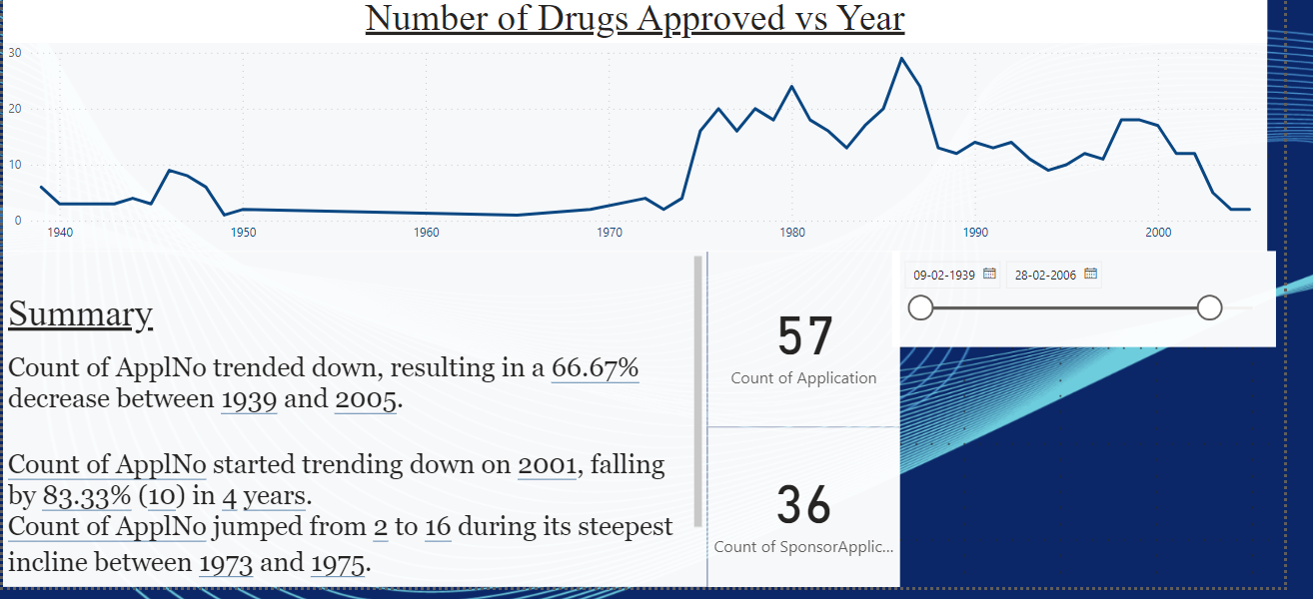
Q1 Visualize the yearly approval trends of drugs. Highlight any significant patterns and/or fluctuations, if any.?
GRAPH
SELF GENERATED SUMMARY

Slide 6
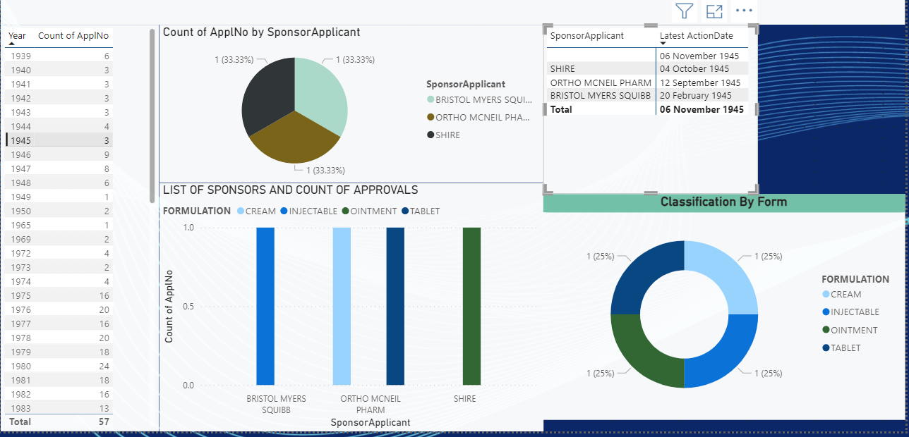
Q2) Explore approval trends over the years based on sponsors?

Slide 7
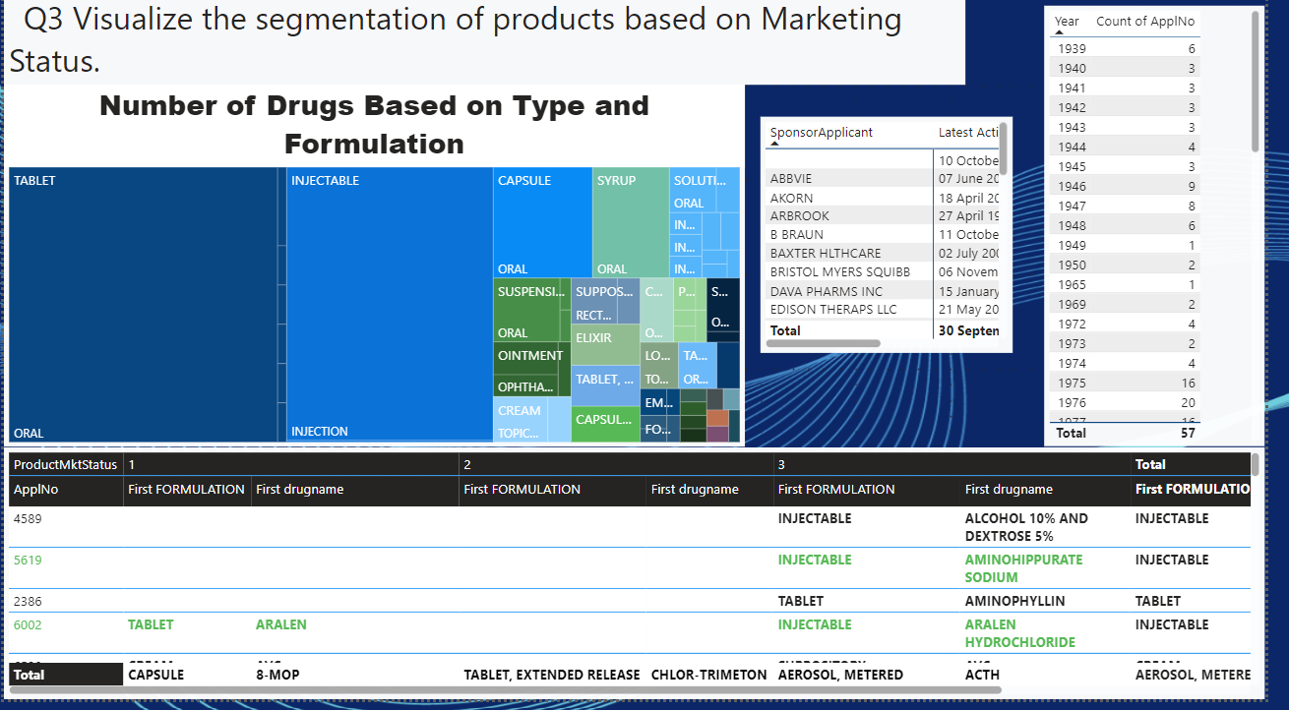
Q3) Visualize the segmentation of products based on Marketing Status?

Slide 8
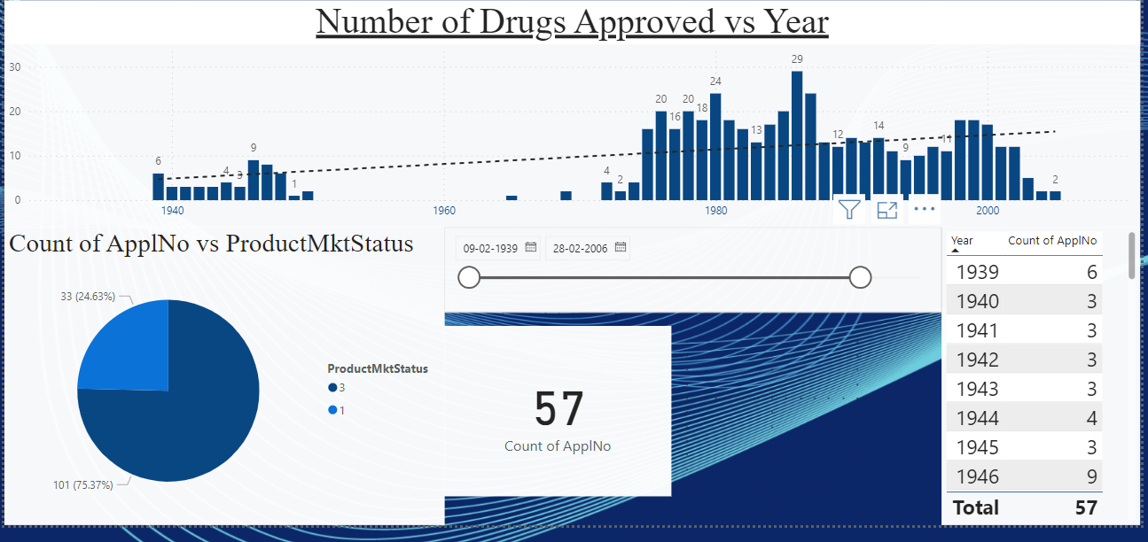
Q4.) Show the total number of applications for each Marketing Status. Enable users to filter by years and Marketing Status for detailed analysis?

Slide 9
Thank You

